Slide 1
NODE.JS
(The Backend Of MERN Stack)
Lecture 44

Slide 2
Today’s Agenda
What Is Passport JS ?
Benefits
Passport Strategies
A Working Example For Login Authentication
Exercise

Slide 3
What is passport js ?
Passport is a robust NodeJS package that easily allows a developer to incorporate login/logout functionality into applications.
With it, we can easily integrate the authentication mechanism into any Node-Express-based app with few lines of code.

Slide 4
benefit
The most important benefit of using passport and its allied packages is that all the heavy lifting required for authentication and authorization is done by the server like:
saving the user credentials in DB.
reading and validating credentials from DB.
verifying whether a user is logged in or not before accessing any protected page.

Slide 5
About passport strategies
Strategies in Passport are authentication mechanisms i.e the way we want Passport to validate a user during login.
The Passport library provides more than 500 strategies created to suit individual means of authentication , like:
passport-local: Uses local username and password authentication.
passport-facebook: To authenticate with Facebook.
passport-twitter: To authenticate with Twitter.
passport-google: To authenticate with Google.

Slide 6
Which strategy we will use?
We will be using local authentication with mongoose in this course.
It means we will use Passport/Mongoose combination to:
set up our DB .
add user credentials in the DB .
validate these credentials at the time of login .

Slide 7
What we will do ?
In this example we will create a functional login page with complete authentication and authorization having the following features:
A login form for a Node application using Passport.
Using the session authentication strategy with Passport.
Connecting Passport to a MongoDB database to store user data
Authorizing only logged-in users to access a secret page.

Slide 8
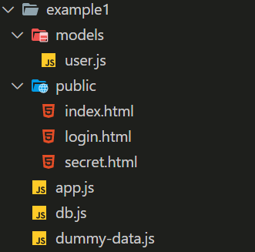
Application structure

Slide 9
Packages required
We will need a total of 7 packages as listed below:
Package | Purpose
express | The Express framework for our web application
express-session | To create and manage the sessions
mongoose | To connect with MongoDB
passport | The authentication library
passport-local | The authentication strategy
passport-local-mongoose | To integrate mongoose with passport-local
connect-ensure-login | The authorization middleware that makes it easy to restrict access to pages.

Slide 10
Installing required packages
To begin with we will install all the 7 packages using the npm install command:
npm install express express-session mongoose passport passport-local passport-local-mongoose connect-ensure-login
Next, we will create our db.js and develop the 3 static html pages inside the public folder of the application.

Slide 11
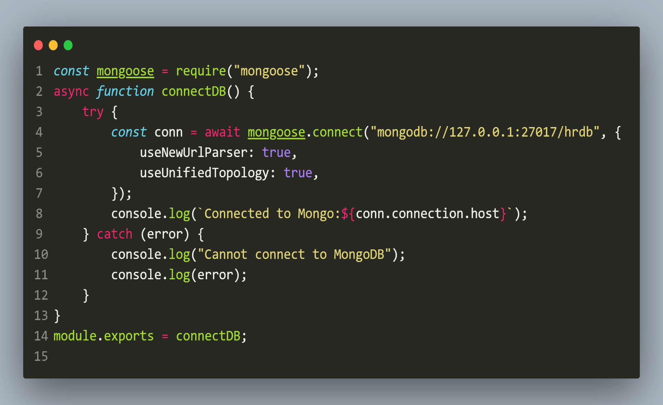
The db.js FILE

Slide 12
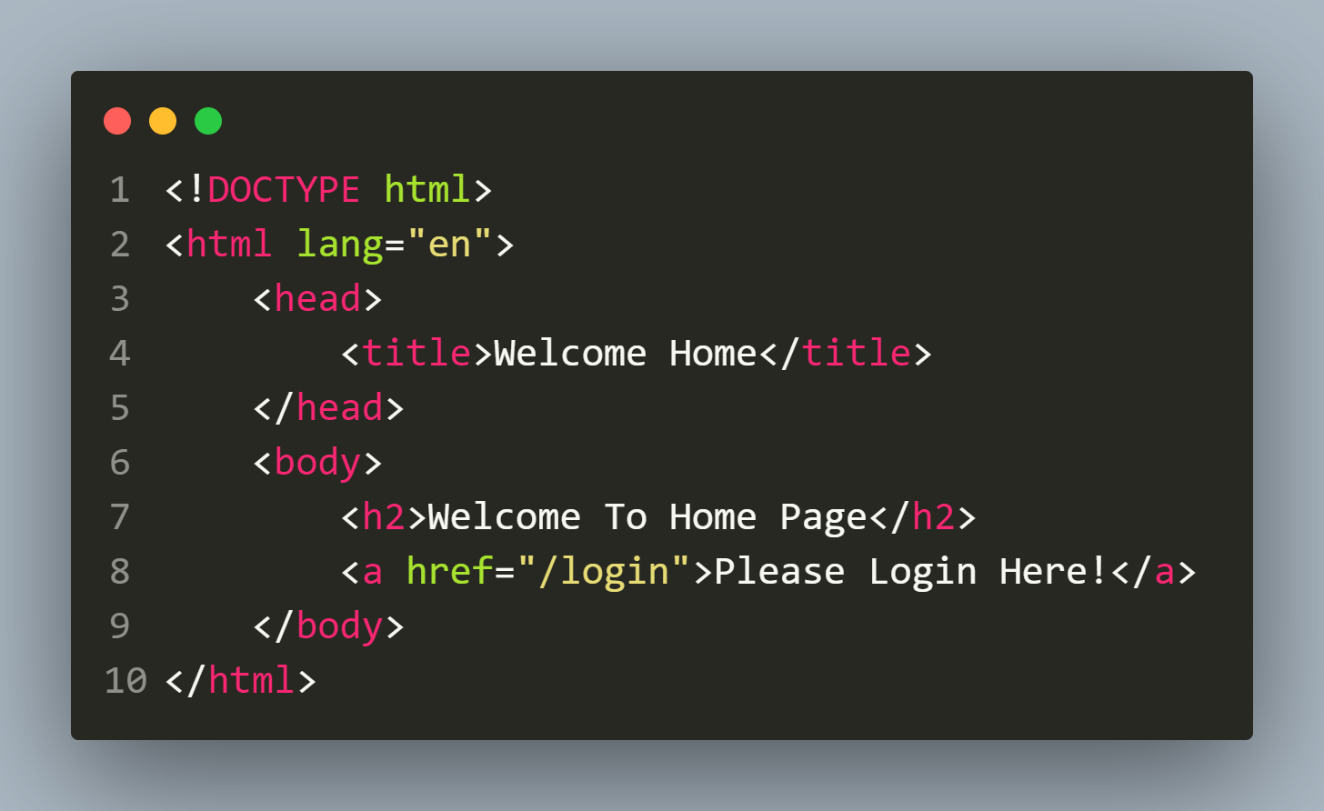
Creating html pages
public/index.html

Slide 13
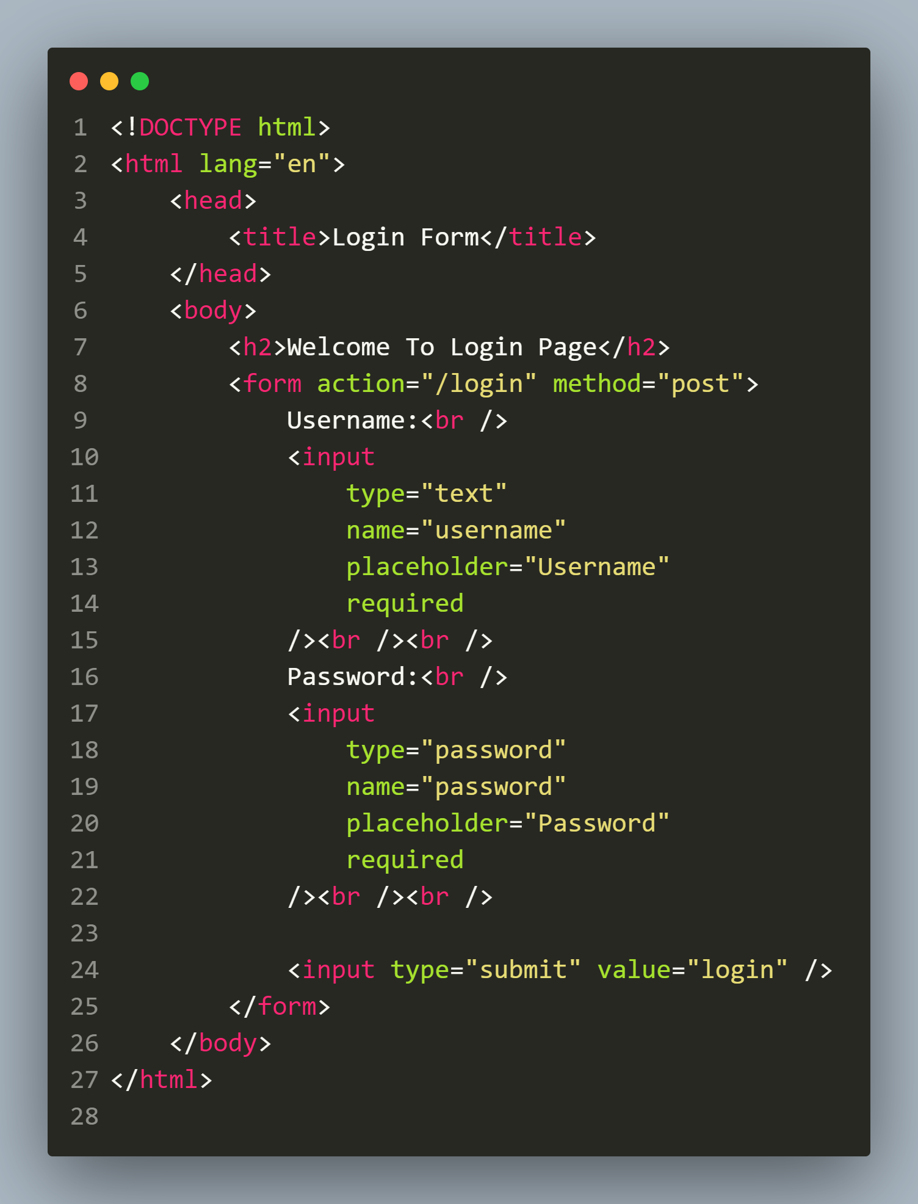
Creating html pages
public/login.html

Slide 14
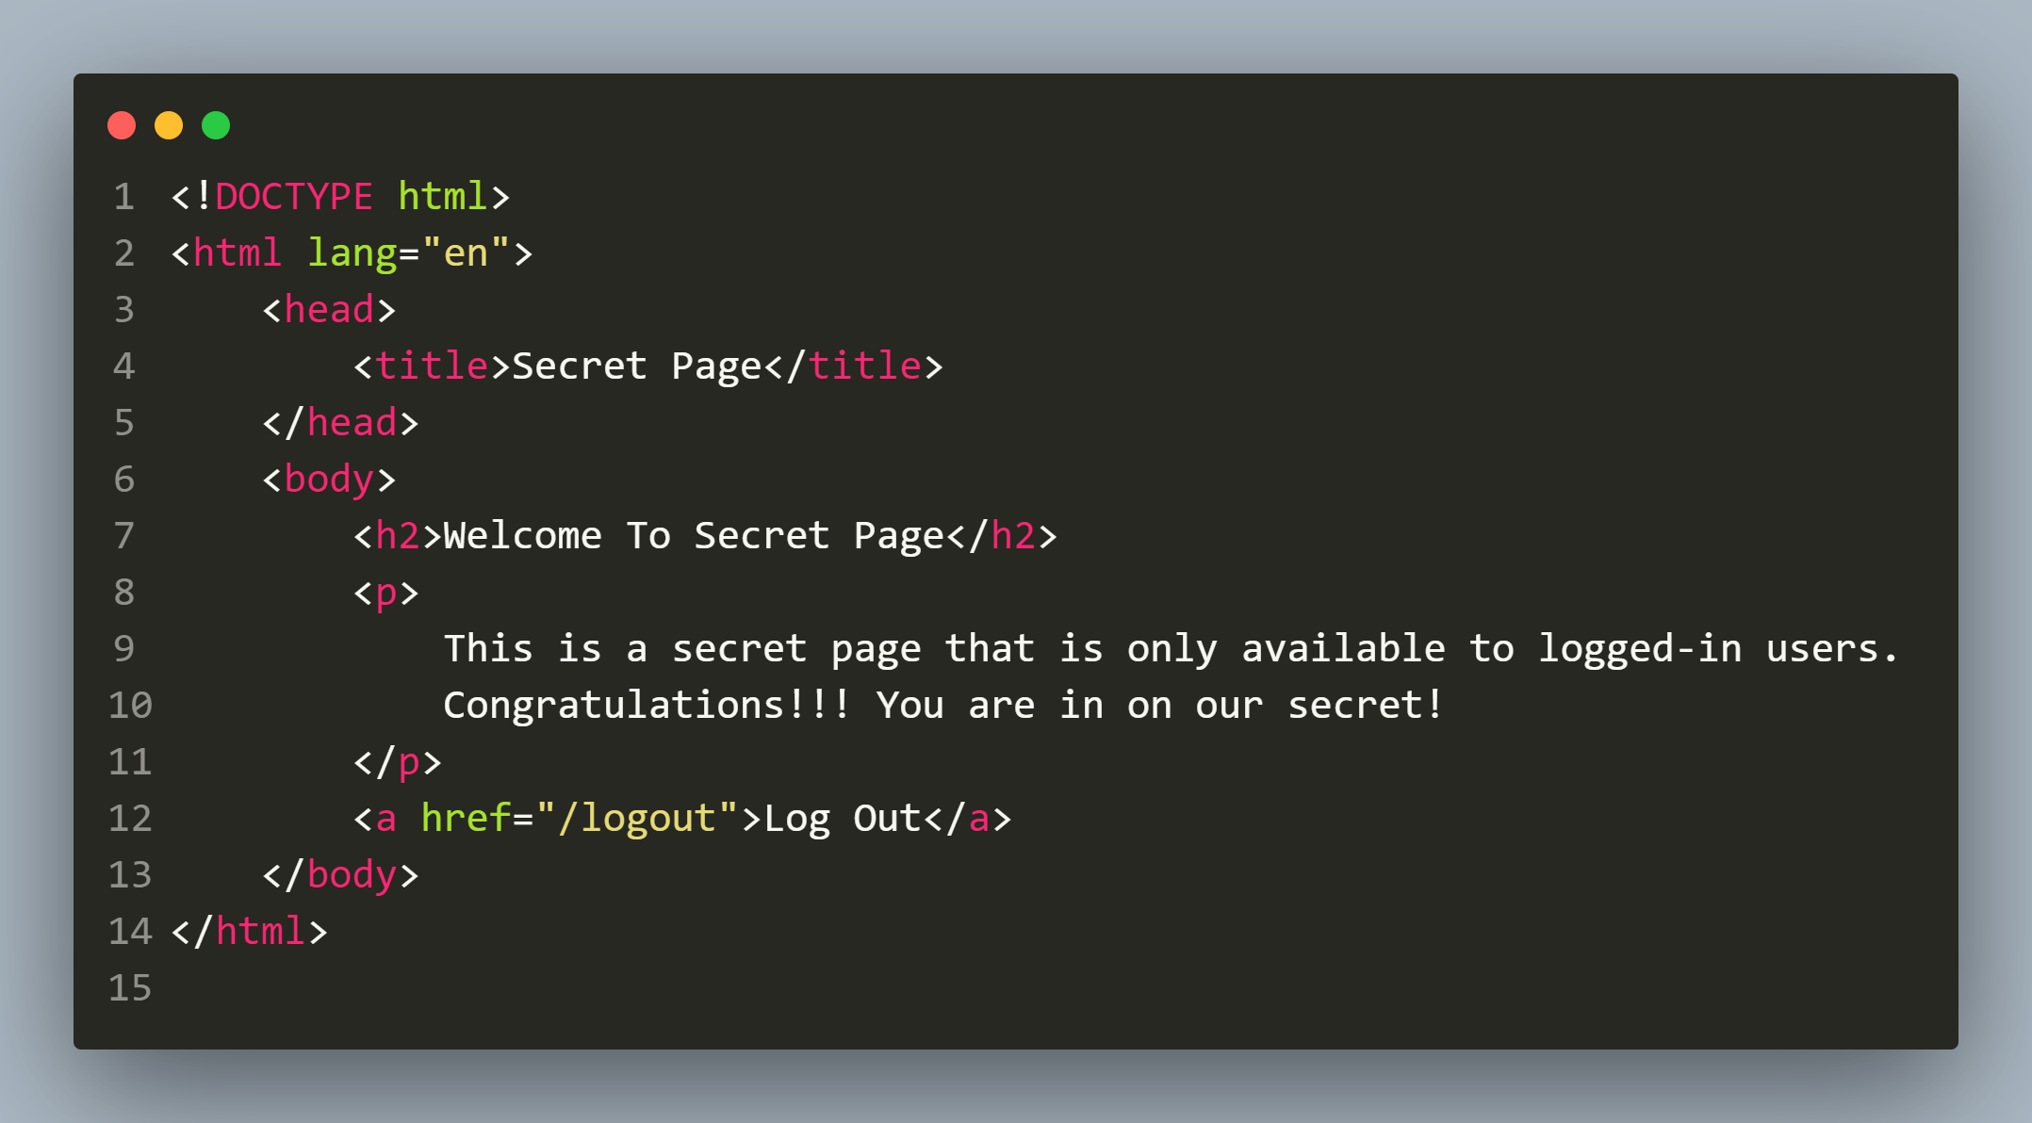
Creating html pages
public/secret.html

Slide 15
Developing our model
Now we will create our User model using passport-local-mongoose.
It will be almost same as our previous model files but with 2 new changes that you should figure out.

Slide 16
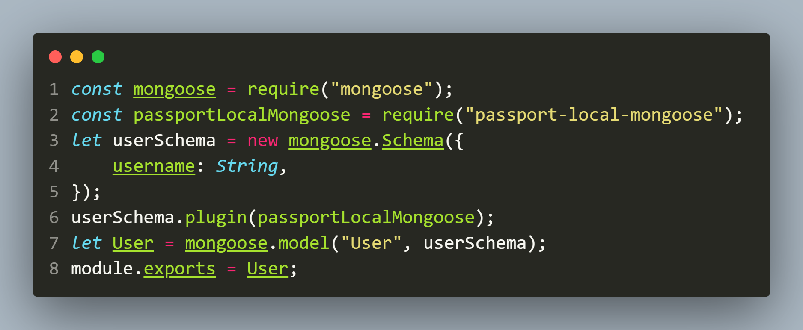
The user.js file
model/user.js

Slide 17
Important points about model
In this schema:
We didn’t add any field for passwords because passport-local-mongoose doesn’t need any password field.
Moreover , we're free to define our User how we like but passport-local-mongoose will add a username, hash and salt field to store the username, the hashed password and the salt value.
Additionally, passport-local-mongoose adds some methods to our Schema/Model.

Slide 18
Important methods added by passport-local-mongoose
Method | Description
register(user, password, cb) | Convenience method to register a new user instance with a given password. Checks if username is unique and generates an exception called UserExistsError if user is present
createStrategy() | Creates a configured passport-local LocalStrategy instance that can be used in passport.
serializeUser() | Generates a function that is used by Passport to serialize users into the session
deserializeUser() | Generates a function that is used by Passport to deserialize users into the session

Slide 19
Important exceptions added by passport-local-mongoose
Method | Message
UserExistsError | A user with the given username is already registered.
MissingUsernameError | No username was given.
MissingPasswordError | No password was given.
IncorrectUsernameError | Password or username are incorrect
IncorrectPasswordError | Password or username are incorrect

Slide 20
Adding some dummy users
To test our application, we will need some registered users in the DB.
So we will insert 2 records in the MongoDB database using register() method provided to us by passport-local-mongoose on our model.

Slide 21
Adding some dummy users
Syntax:
<Model>.register(obj,str,cb)
Explanation:
This method accepts an object as first argument containing all the fields mentioned in our Schema and their values.
The second argument to this method is password to be stored , to which salt and hash will be added.
The third argument is an optional callback.
We can also use register() method’s promise based version using async/await.

Slide 22
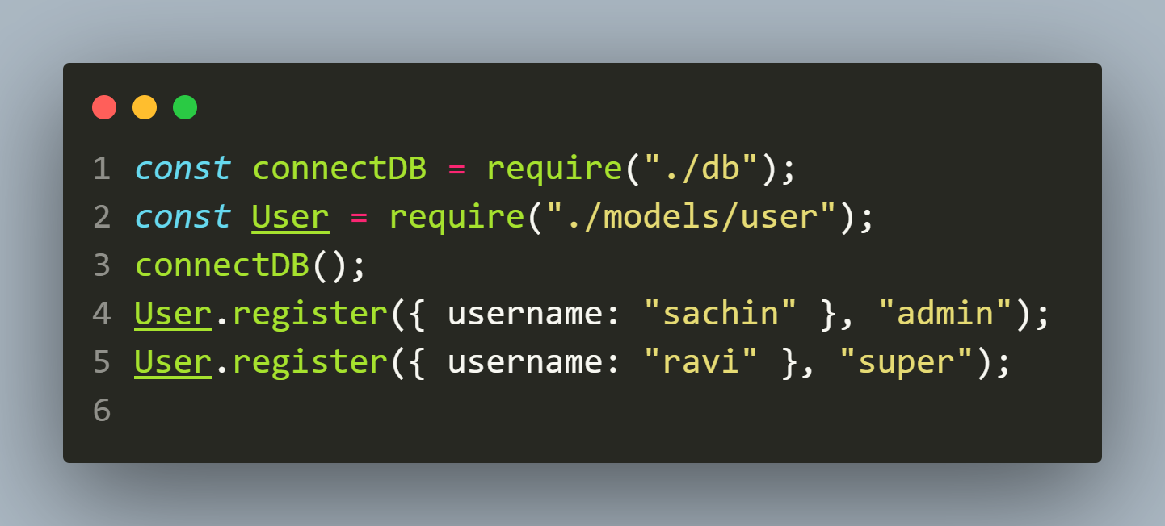
The dummy-data.js file
/dummy-data.js

Slide 23
Creating app.js
The final step is to create the app.js file in which we will do the following:
Loading all the required modules.
Configuring basic settings in express.
Initializing the passport module.
Setting up strategy.
Configuring all the required routes.

Slide 24
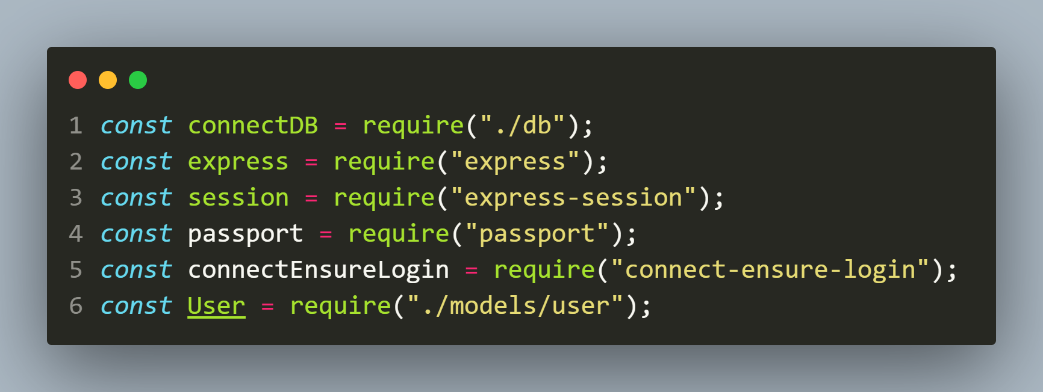
app.js-Loading all the required modules
/app.js

Slide 25
app.js-Basic set up
After loading the required modules we need to do some basic set up like:
instantiate express
connect to the DB
configure our session object
setting up middleware for form data
Setting up session is needed because passport will use session to store user details

Slide 26
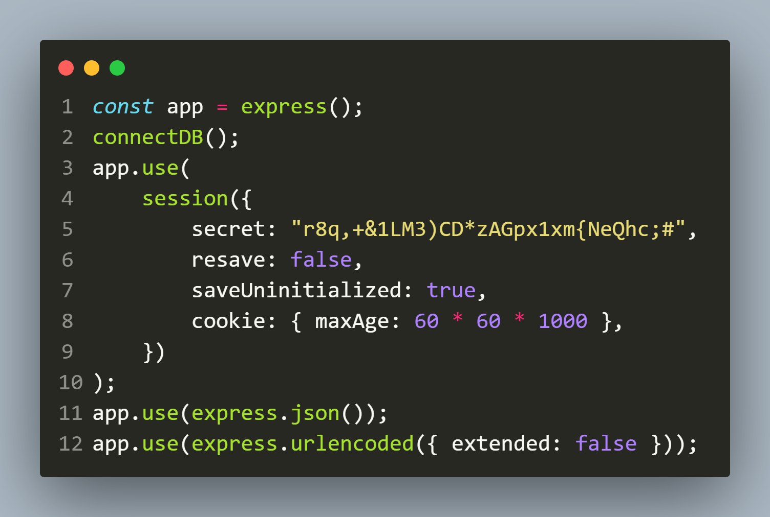
app.js-Basic set up
/app.js

Slide 27
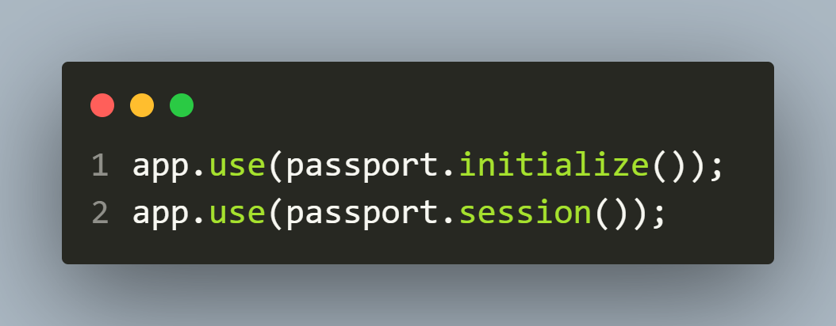
app.js-initializing passport
After configuring Express we need to initialize Passport and this is done using following 2 lines of code:

Slide 28
app.js-initializing passport
The first line simply initializes Passport within our Express application.
The second line sets Passport as a middleware and allows it to use express session and cookie for populating User data.

Slide 29
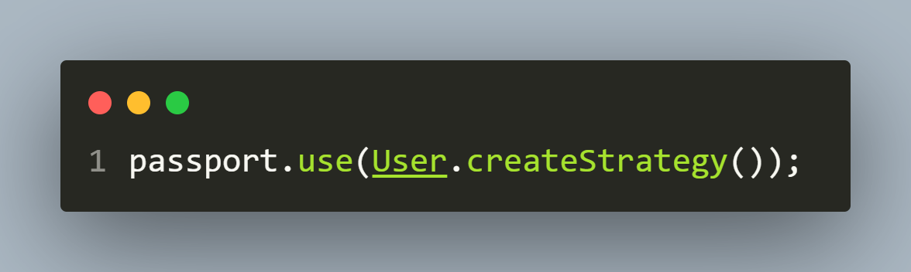
app.js-setting up strategy
Before doing any authentication, our strategy must be declared and configured.
Our strategy module, passport-local-mongoose, does the heavy lifting of creating the strategy for us, so all we need is the code below.

Slide 30
WHAT DOES createStrategy() DO ?
The createStrategy() method is added to our Model by the package passport-local-mongoose .
It automatically performs authentication of user credentials.

Slide 31
WHAT DOES createStrategy() DO ?
In case, we are using only the passport package without the package passport-local-mongoose then we will have to write some code ourself to compare passwords and all.
But due to passport-local-mongoose, only this 1 line is enough.

Slide 32
app.js-serializing/deserializing
Passport also needs to save and retrieve user instances from a session store in order to support login sessions, so that every subsequent request will not contain the user credentials.
For this it provides two methods: serializeUser() and deserializeUser(), on Model instance.

Slide 33
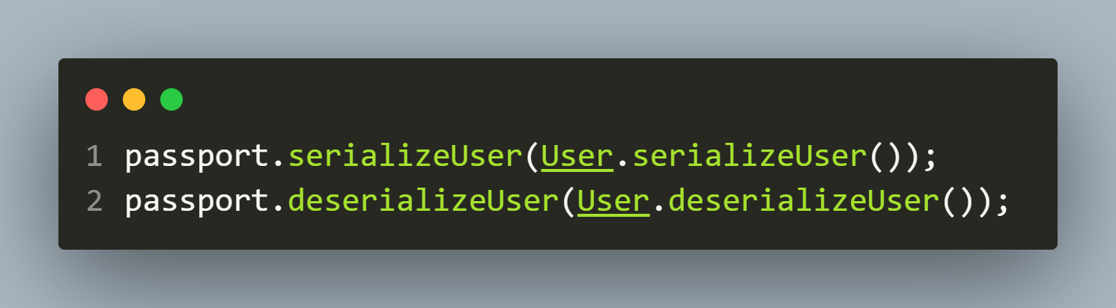
app.js-serializing/deserializing
The serializeUser() method is used to persist a user's data into the session after successful authentication, while the deserializeUser() method is used to retrieve a user's data from the session.

Slide 34
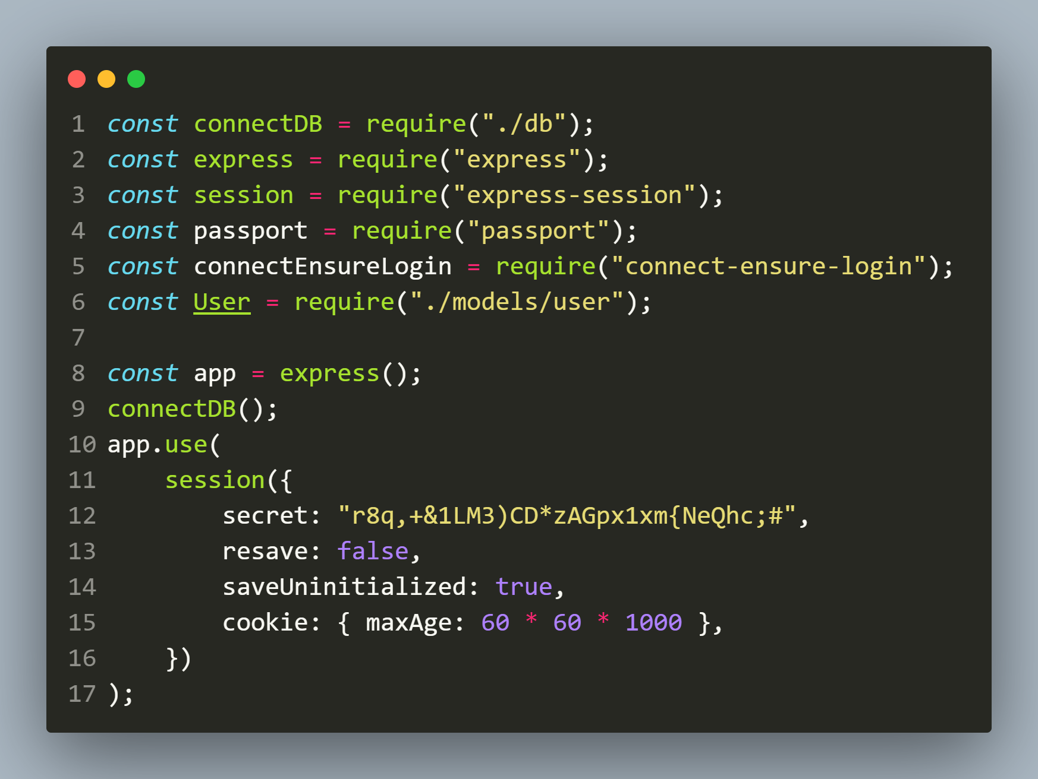
THE app.js FILE TILL NOW

Slide 35
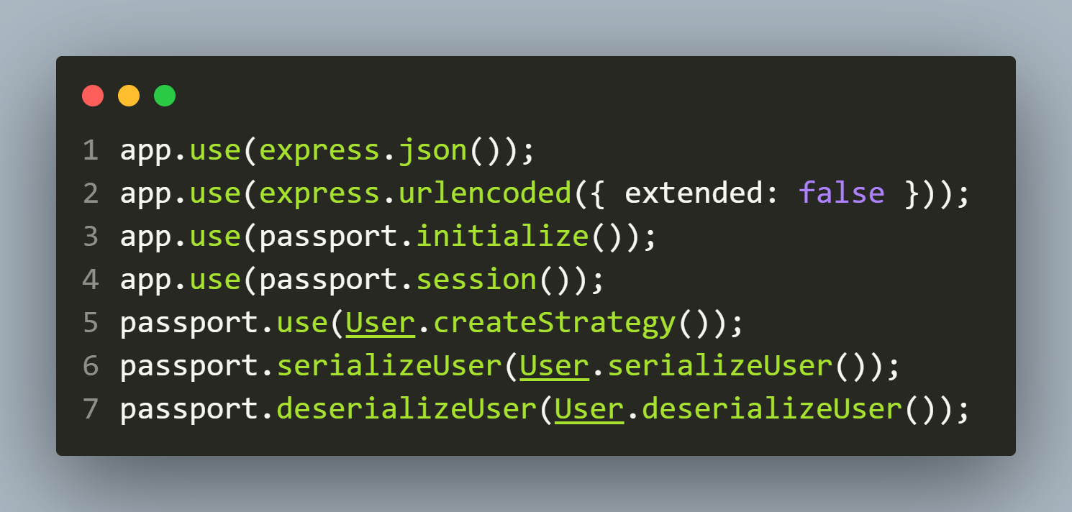
THE app.js FILE TILL NOW

Slide 36
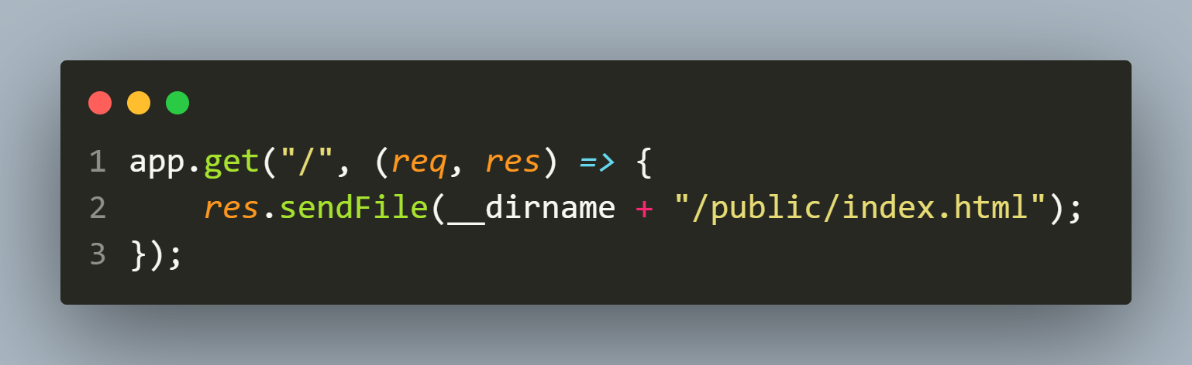
app.js-configuring routes
Now we will code the routes for our application and we will begin with the home route which is accessible to everyone.

Slide 37
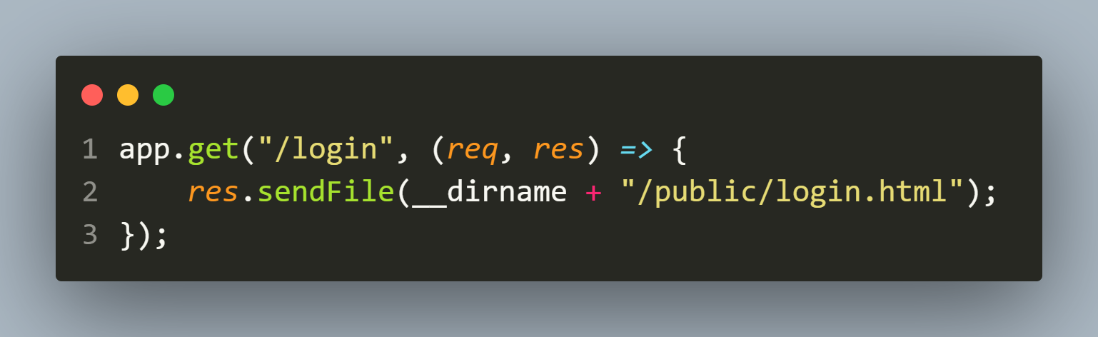
app.js-configuring routes
Next we will code the route for login page and it is also accessible to everyone.

Slide 38
app.js-configuring routes
Then we create one of the most important route which is for logging in a user.
That is we need to authenticate the user based upon his credentials and redirect him either to dashboard if credentials are correct or to the login page again if the credentials are wrong.

Slide 39
app.js-configuring routes
For this we configure a POST route /login which calls the authenticate() method given by Passport.
Syntax:
passport.authenticate(‘str’,obj)

Slide 40
app.js-configuring routes
This method accepts 2 parameters:
'local': The primary strategy we are using.
failureRedirect: A key representing the route to which the user will be redirected if the authentication fails.
If they do authenticate, passport attaches the user data to the request object and the code inside the callback will execute.

Slide 41
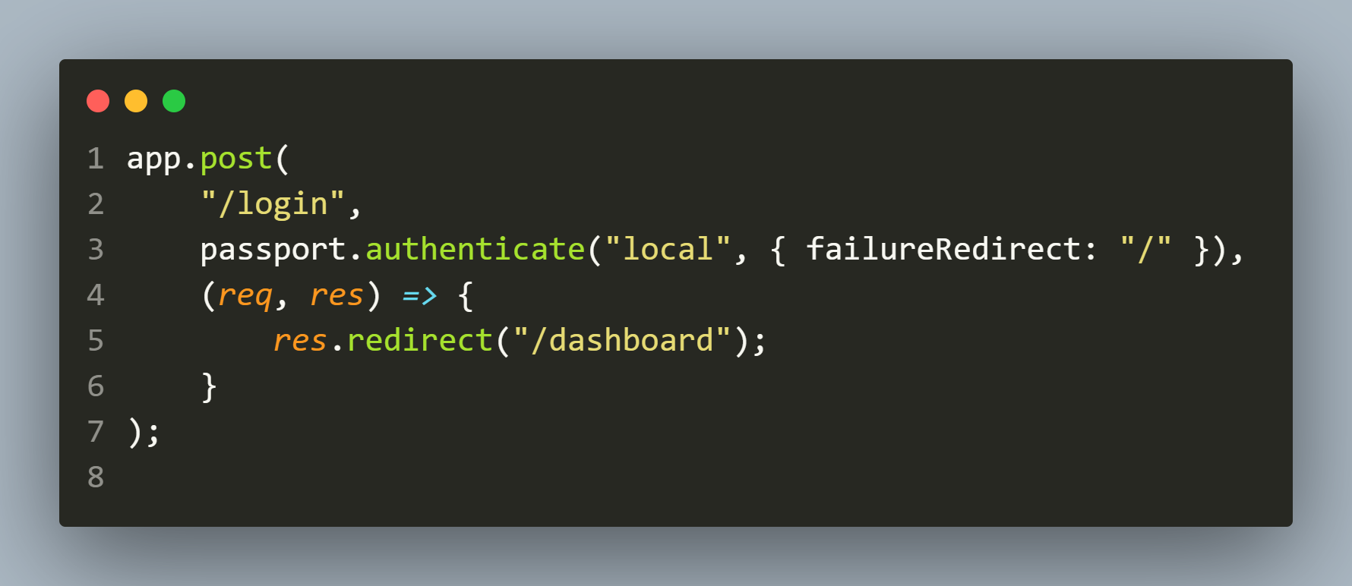
CODE FOR login ROUTE

Slide 42
app.js-configuring routes
Next we will code the route for dashboard which is only accessible to logged in users.
But the question is how will we check whether the user is logged in or not ?
The answer is : using the package connect-ensure-login.

Slide 43
ABOUT connect-ensure-login
The package connect-ensure-login is a middleware and It ensures that a user is logged in before accessing a protected page .
If a request is received that is unauthenticated, the request will be redirected to the login page.

Slide 44
HOW TO USE connect-ensure-login ?
To use connect-ensure-login we take 2 steps:
Import it in our application and this returns an object which has a method called ensureLoggedIn().
We pass a call to this method as the middleware in all those routes which are for protected pages

Slide 45
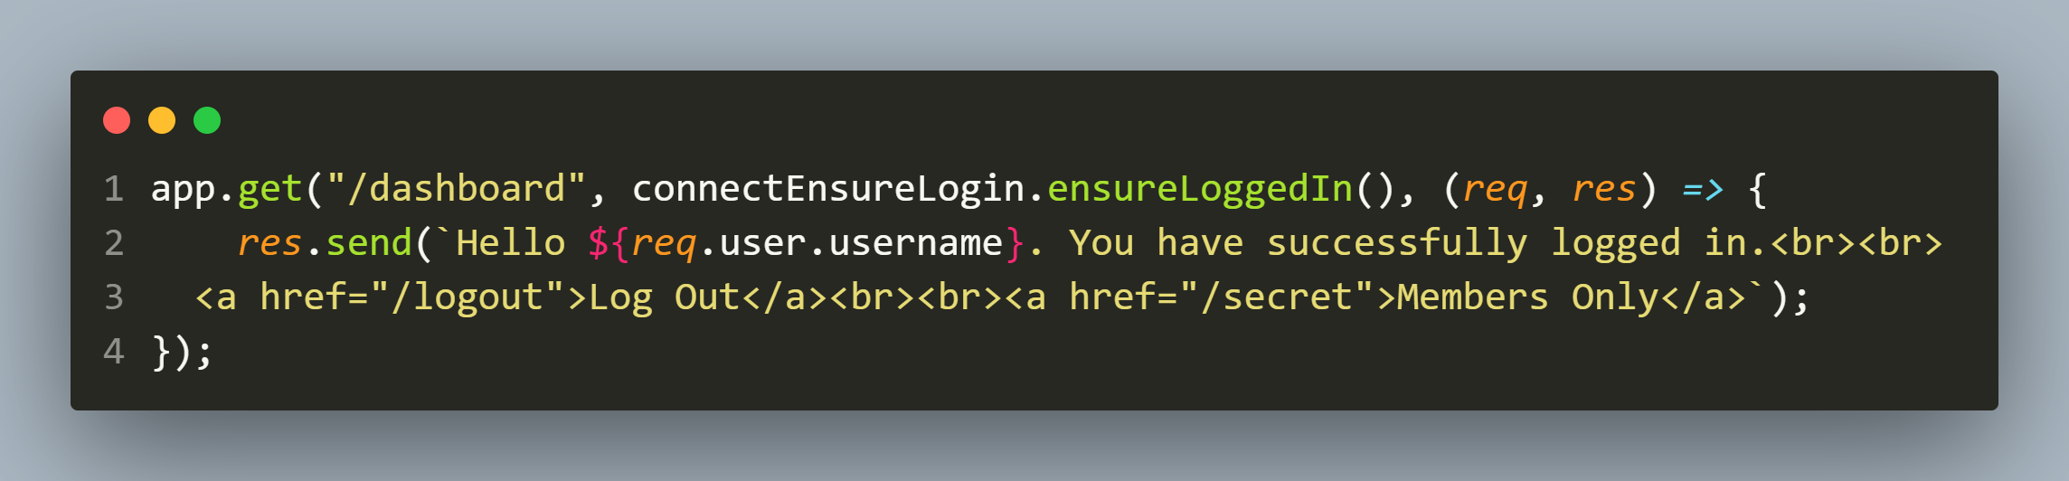
CODE FOR dashboard ROUTE

Slide 46
EXPLANATION
Once navigated to that route, we display a message to our logged-in user.
The message contains
their username
a link to log out of the application: /logout
a link to a members-only page: /secret

Slide 47
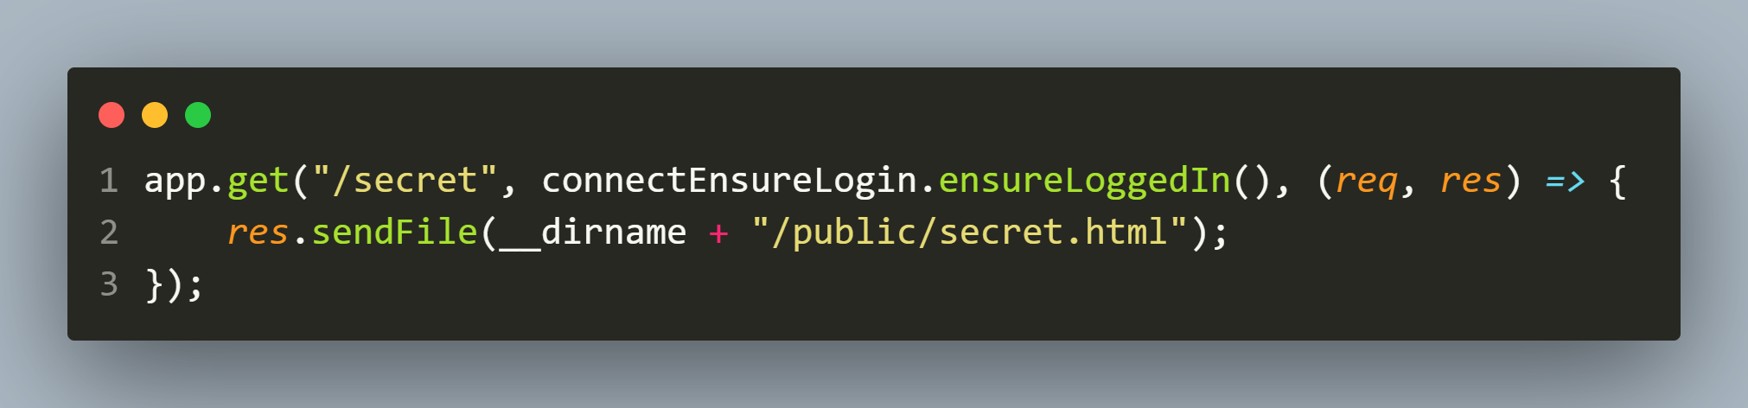
app.js-configuring routes
Our secret page route is also only accessible to logged in users.

Slide 48
app.js-configuring routes
Finally we create a route to logout the user.
For this Passport exposes a logout() method on req object that can be called from any route handler which needs to terminate a login session.
Invoking logout() will remove the req.user property and clear the login session (if any)

Slide 49
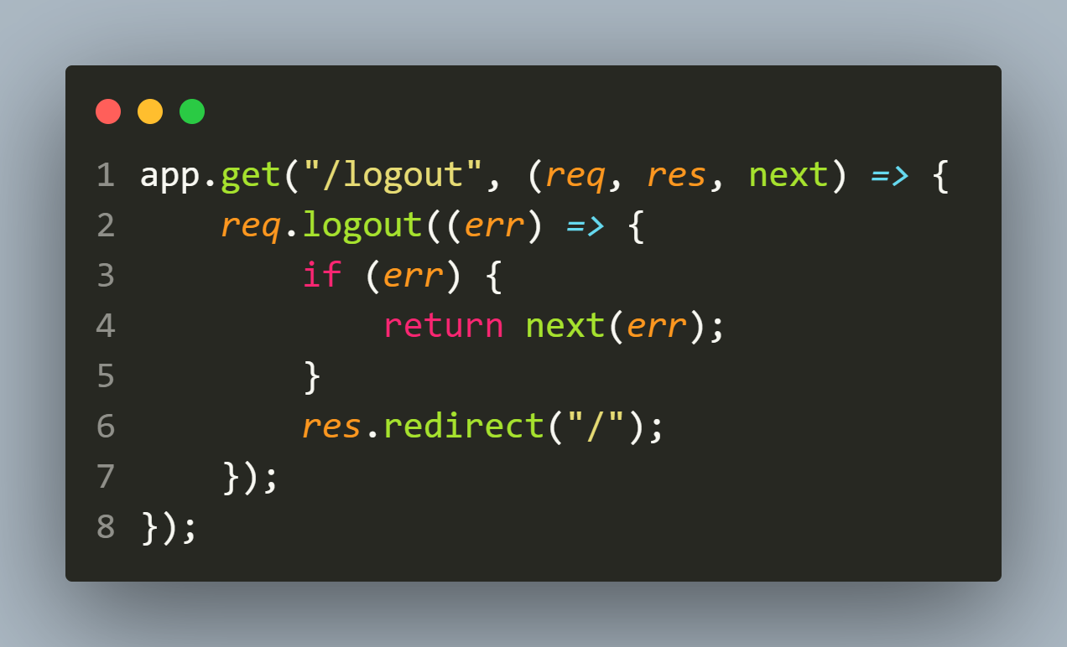
CODE FOR logout ROUTE

Slide 50
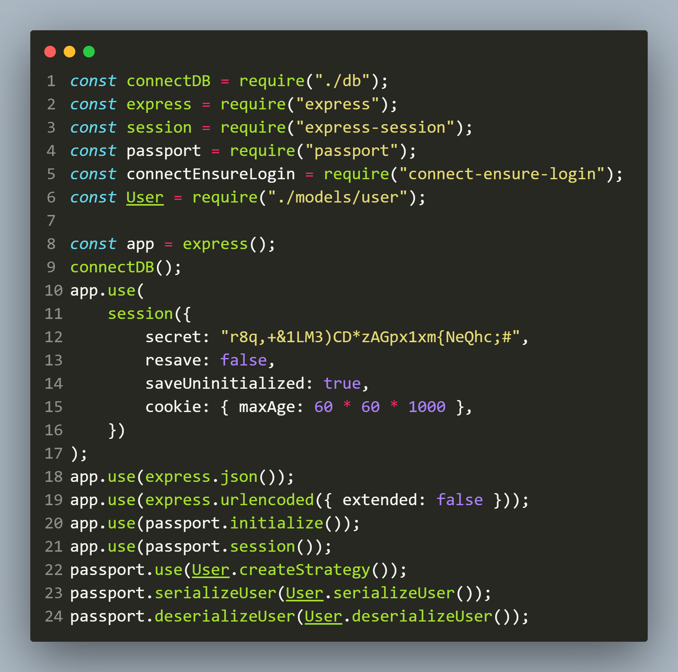
FINAL app.js

Slide 51
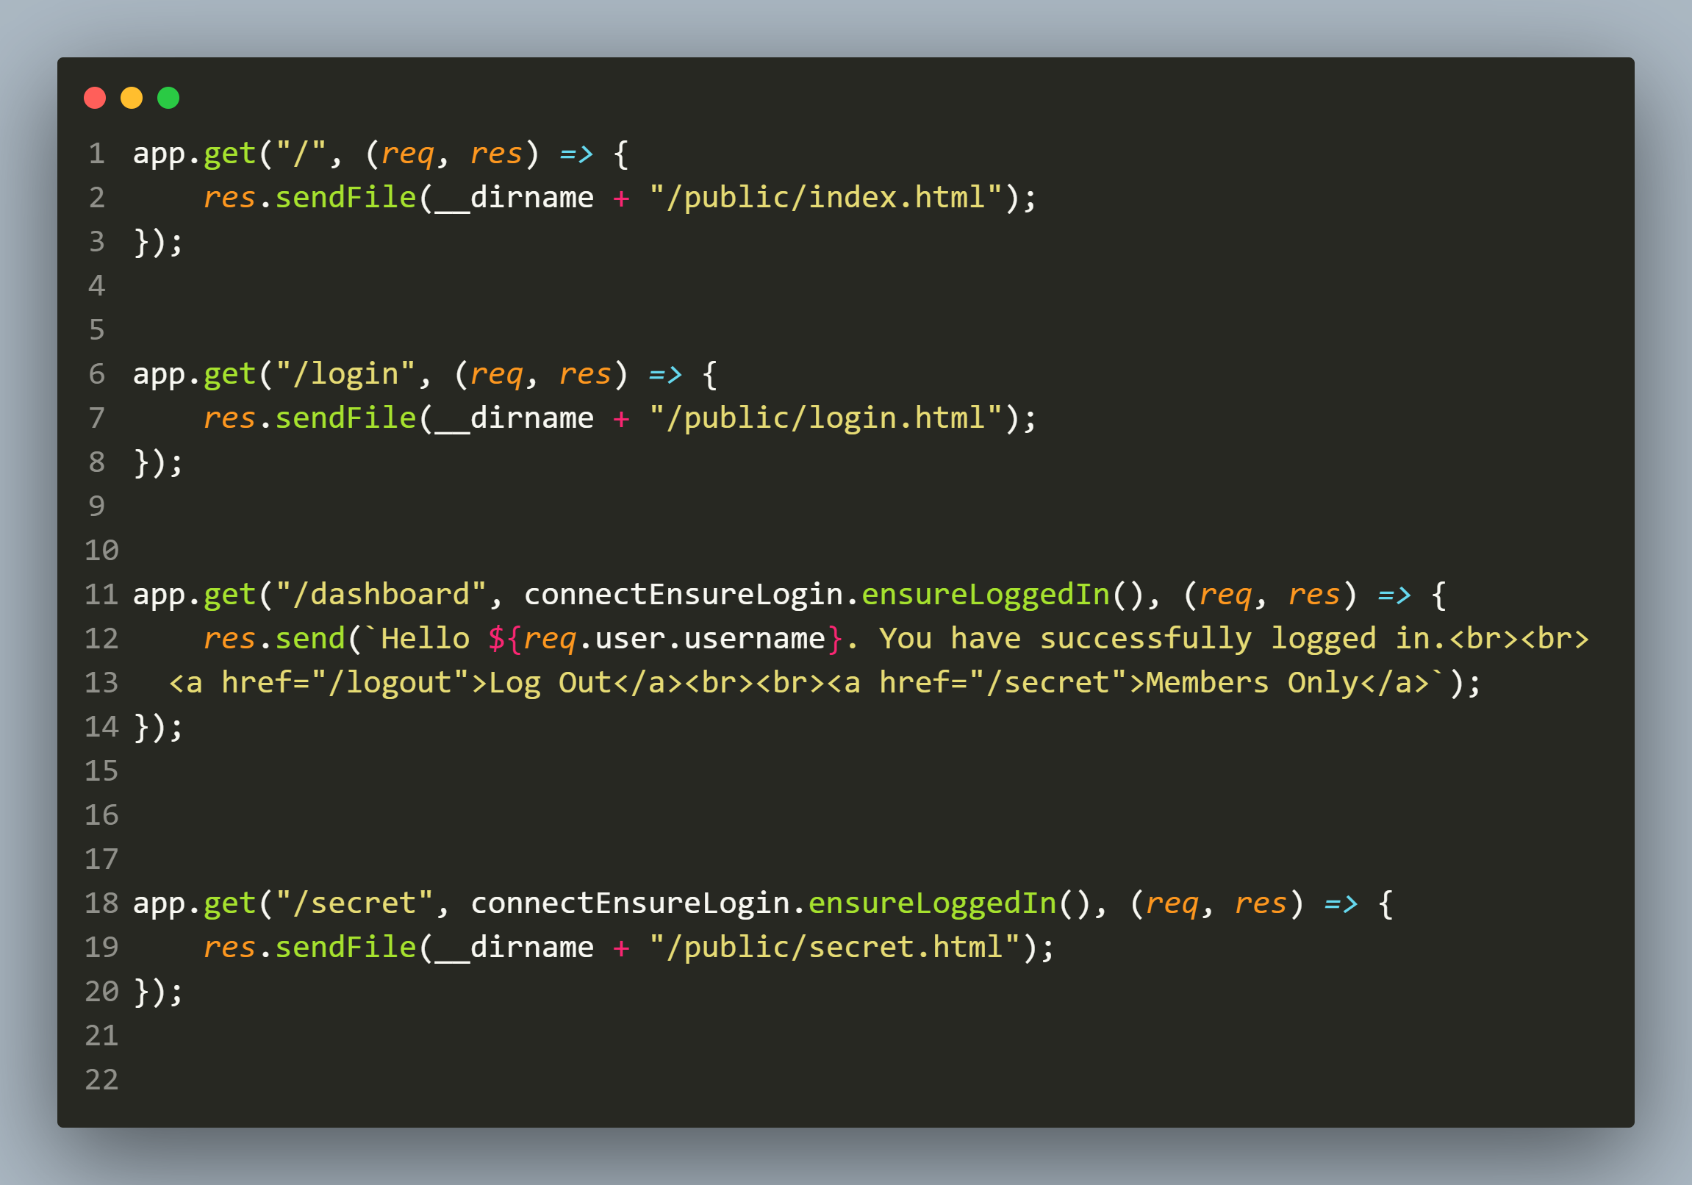
FINAL app.js

Slide 52
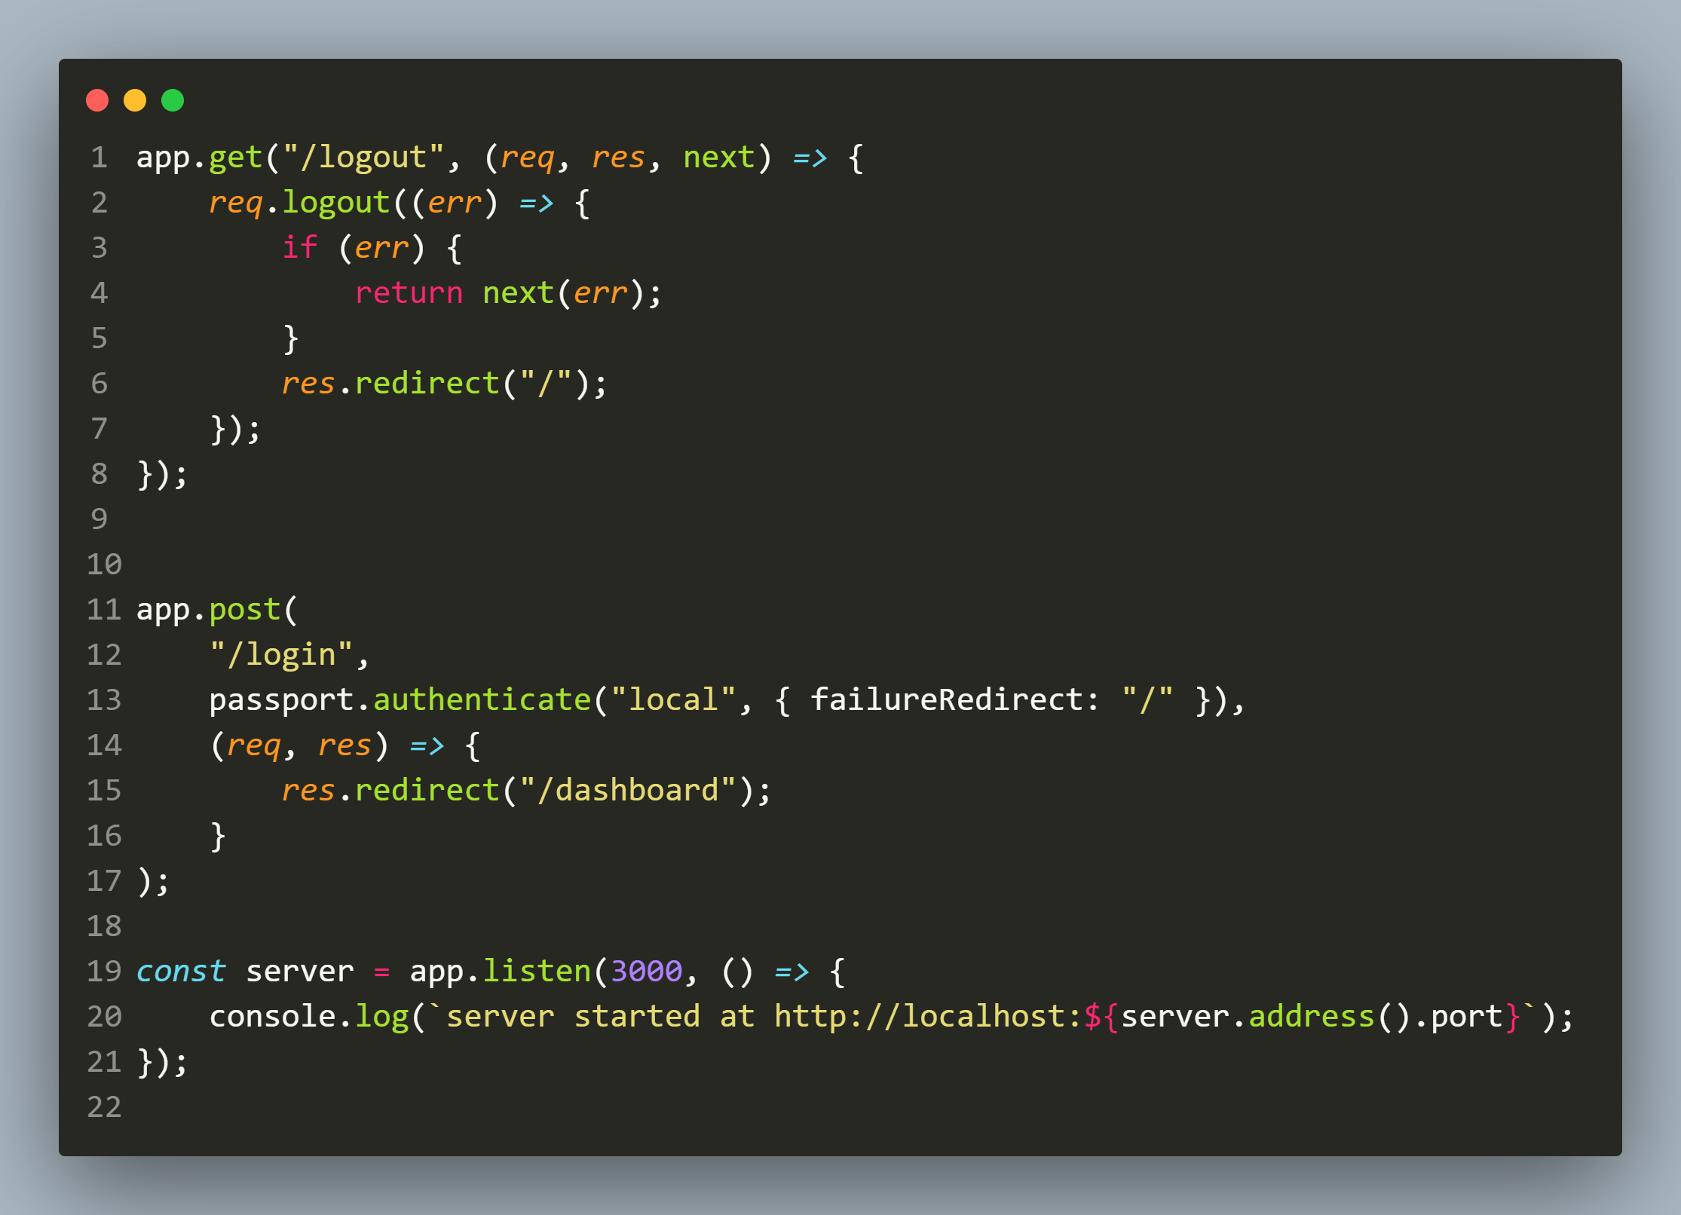
FINAL app.js

Slide 53
Exercise 93
Modify the previous application so that it now provides a link to the user to register also.
In case the registration fails display the actual reason and if the registration is successful then allow the user to login.

Slide 54
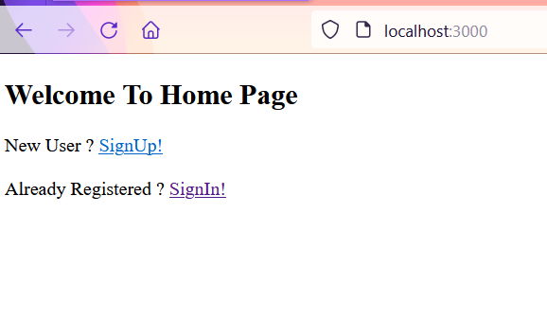
Desired output
http://localhost:3000

Slide 55
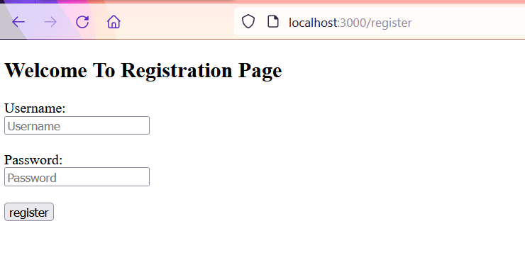
Desired output
On clicking SignUp

Slide 56
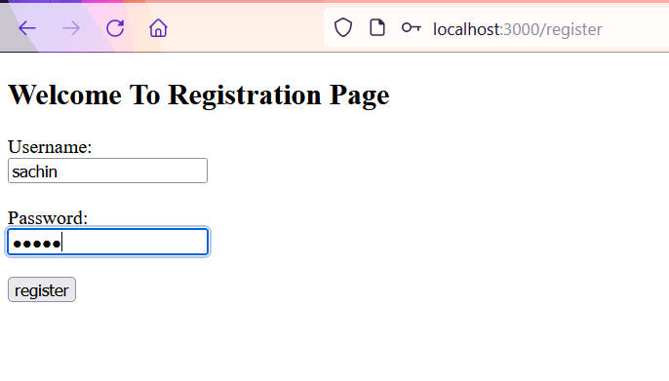
Desired output
If UserName is already present

Slide 57
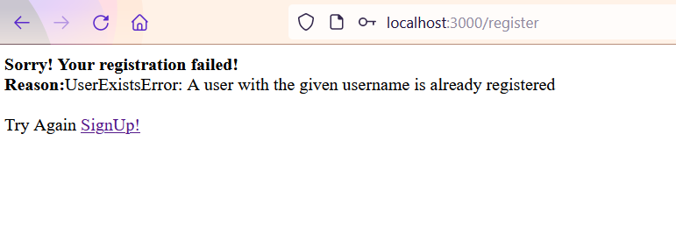
Desired output
If UserName is already present

Slide 58
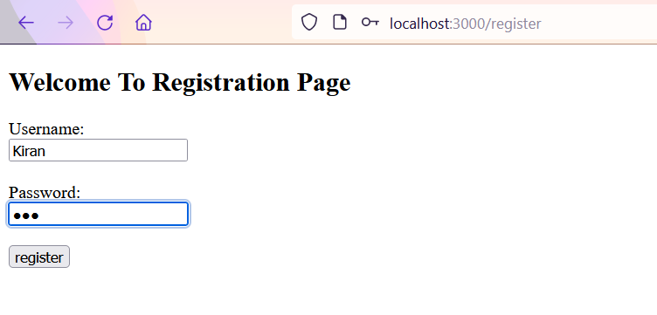
Desired output
On Registering Successfully

Slide 59
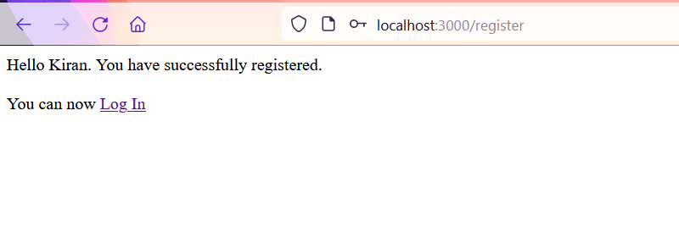
Desired output
On Registering Successfully

